Slide 1
SPOTIFY DATASET ANALYSIS

Slide 2
AGENDA
DATASET DESCRIPTION
DETAILED ANALYSIS
INSIGHTS AND OBSERVATIONS
CONCLUSION

Slide 3
OBJECTIVE:
To explore a large Spotify track dataset using data analysis.
To understand how audio features (danceability, energy, tempo, etc.) are distributed.
To study how these features related to track popularity.
To identify patterns and insights useful for music recommendation / understanding trends.

Slide 4
DATASET DESCRIPTION
Total tracks (rows): 62,317
Total attributes (columns): 22
Contains:
  Track & artist information
  Audio feature scores (0–1 scale mostly)
  Popularity score (0–100)
  Year & language

Slide 5
BASIC UNDERSTANDING OF THE DATASET
🎼 Categorical Columns:
track_id – Unique identifier for each track in Spotify.
track_name – Name/title of the song.
artist_name – Name of the performing artist(s).
album_name – Album to which the track belongs.
track_url – Direct URL link to play the track on Spotify.
artwork_url – URL for the album or track cover art.
year – Release year of the track.
language – Primary language of the track’s lyrics

Slide 6
🎧 Audio & Numeric features:
popularity – Integer score (0–100) representing track audience engagement & streams.
danceability – How suitable a track is for dancing (-1 to 1) based on rhythm & beat stability.
energy – Overall intensity and activity of the track (-1 to 1).
acousticness – Probability that a track is acoustic, i.e., not electronic or heavily produced.
instrumentalness – Likelihood that a track has no vocals (-1 to 1).
loudness – Decibel measure of track loudness (range ~ −60 to 0).
speechiness – Presence of spoken words in the track (speech-like content).
liveness – Detects the presence of audience in the recording. (-1 to 1)
valence – Positivity of the musical mood (happy vs sad sounding).
tempo – Beats per minute (BPM), rhythm pace of the song.
duration_ms – Length of the track in milliseconds.
key – The key the track is in . .
mode – Musical mode: major (1) or minor (0).
time_signature – Estimated beats per bar.

Slide 7
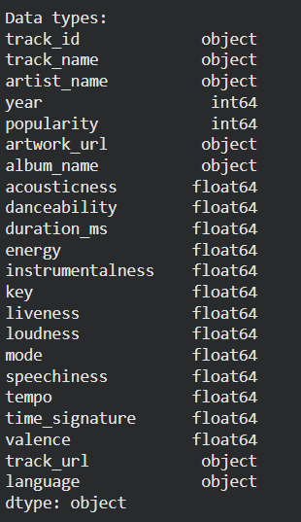

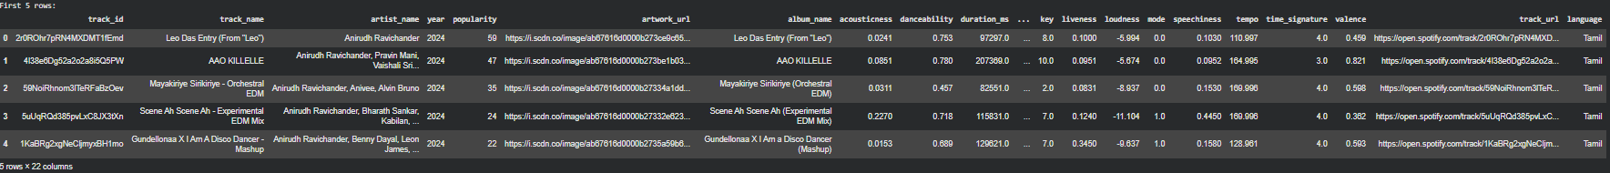
Columns and their datatypes
DEEPER LOOK AT THE DATASET
Initial shape of the dataset (rows x columns)
22 columns:
13 floats
2 integers
7 objects
Removing the duplicates based on track_id
First 5 rows of the dataset (head)

Slide 8
Univariate Analysis
What is Univariate Analysis?
Univariate analysis examines a single variable at a time to understand its individual distribution, range, and statistical behavior.
In the upcoming slides we will:
study how each variable behaves independently using descriptive statistics.
visualize numerical features using histograms, boxplots, and distribution graphs.
interpret each feature’s spread using metrics like mean, median, quartiles, and range.
identify skewness, outliers, and concentration ranges for each attribute.

Slide 9
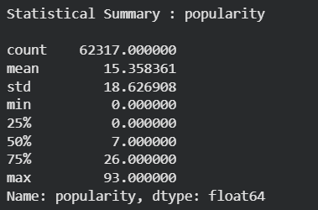
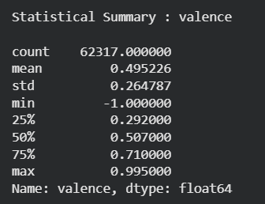
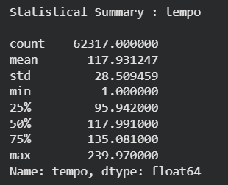
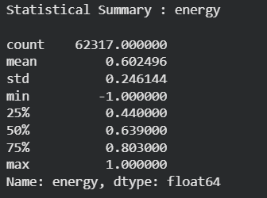
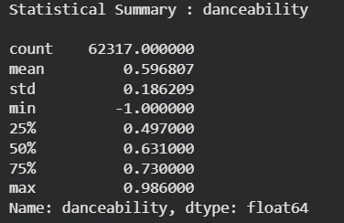
Statistical Data…
Lets try to understand the data more deeply by visualisation →

Slide 10
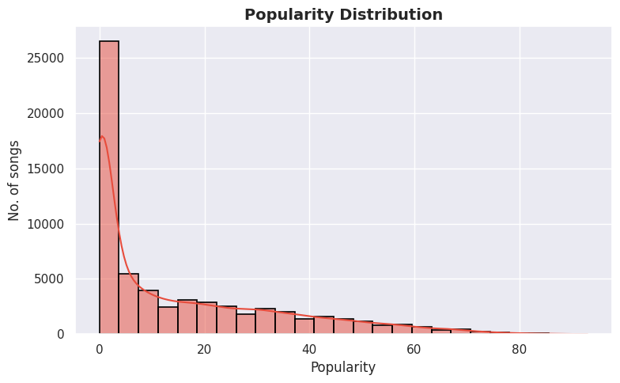
Popularity Scores
The popularity score indicates how widely a song is listened to
The distribution is heavily skewed, meaning only a small portion of songs achieve very high popularity.
Median popularity is low, which suggests that the majority of tracks receive limited engagement.
This shows that on Spotify, a few viral songs dominate listener attention.

Slide 11
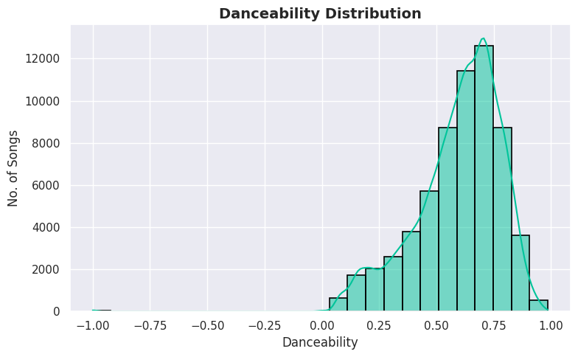
Danceability
Danceability reflects how suitable a track is for dancing — based on rhythm stability & beat strength
Most songs have moderate-to-high danceability (0.5–0.8), showing Spotify’s library favors rhythm-driven and upbeat tracks
Very few tracks have extremely low danceability (< 0.3), meaning most songs possess some rhythmic flow or beat alignment.
The peak density around 0.6–0.7 suggests Spotify’s catalog leans toward tracks suitable for casual or upbeat listening rather than purely acoustic or spoken content.

Slide 12
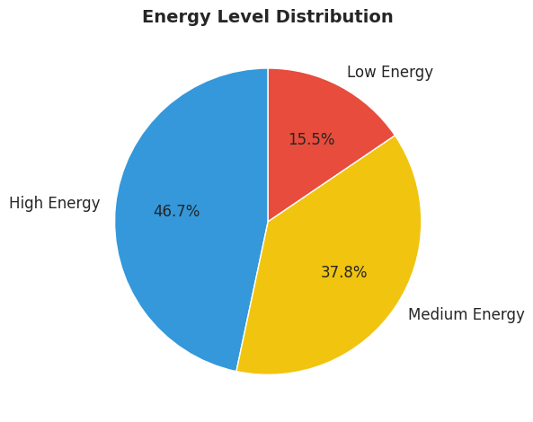
Energy Levels
Energy measures intensity and activity — higher values sound stronger and more powerful
The energy level ranges are as follows :
Low Energy : 0 – 0.33
Medium Energy : 0.34 – 0.66
High Energy : 0.67 – 1.00
High Energy (0.67–1.00) dominates, comprising the majority of tracks, suggesting Spotify has a strong focus on balanced, moderately intense songs suitable for casual listening.
Low Energy (0.00–0.33) is the smallest slice, indicating that very few tracks are calm, acoustic, or mellow.
Most Spotify tracks have high energy, with fewer high-energy songs and very few low-energy tracks, reflecting a bias toward engaging and upbeat music.

Slide 13
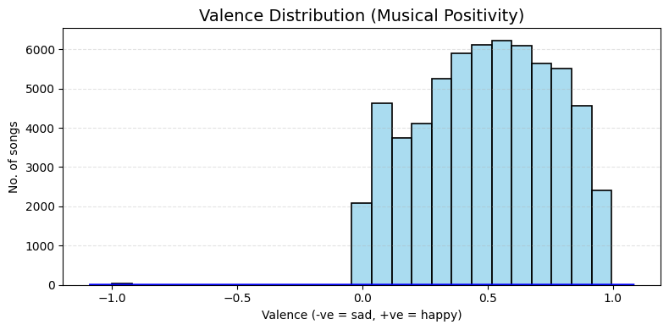
Valence
Valence measures how happy or positive the song sounds
We observe songs spread mainly across 0 to 1
Very negligible number of songs have valence point around –1
This variety suggests that the listeners prefer to listen to jolly type of songs rather than sad ones

Slide 14
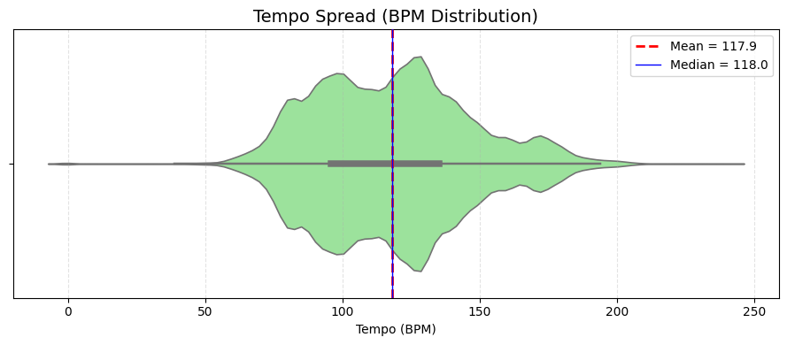
Tempo Distribution
Tempo determines the speed of the song — in beats per minute
Most songs cluster between ~100–130 BPM
This tempo range is known to be naturally engaging to humans
This aligns with typical pop music structure

Slide 15
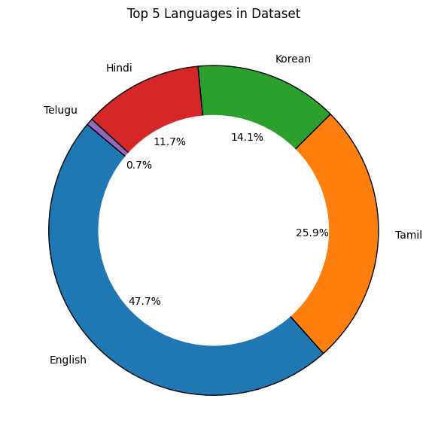
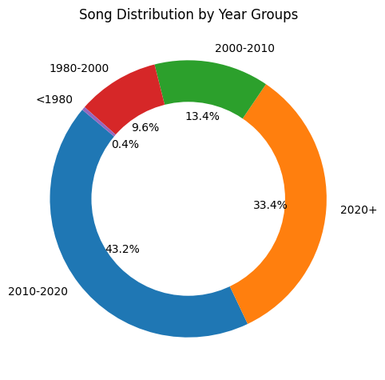
Univariate Analysis for Categorical Data
This suggests that most songs available in this dataset are targeted toward a broad mainstream audience of a particular language
This suggests that popularity and audio features observed will be influenced by modern music styles, not older eras.

Slide 16
Key Insights
Popularity is heavily right–skewed, meaning only a small percentage of songs achieve high listener engagement.
Danceability is moderately high for most tracks, indicating that Spotify songs generally have a rhythmic, movement-friendly feel.
Energy levels are high in majority of tracks, showing preference toward powerful, intense, lively music.
Valence (emotional positivity) mainly lies between 0 to 1, meaning listeners prefer happy songs rather than sad songs.
Tempo clusters around ~100–130 BPM, suggesting most tracks follow typical human-preferred rhythm ranges.
Language distribution shows dominance of one main language, with others forming minor segments — indicating asymmetric linguistic representation.
Year-group distribution shows majority of tracks from modern eras (2010–2020), suggesting dataset bias toward recent streaming-era content

Slide 17
Bivariate Analysis
What is Bivariate Analysis?
Bivariate analysis examines the relationship between two variables to understand how changes in one affect the other.
In the upcoming slides we will:
analyze pairwise relationships between musical features.
use scatter plots to observe directional trends between variables.
apply boxplots and grouped comparisons to evaluate category-level patterns.
see how features like tempo, danceability, and duration interact with popularity.
interpret how two-variable combinations reveal stronger insights than individual features.

Slide 18
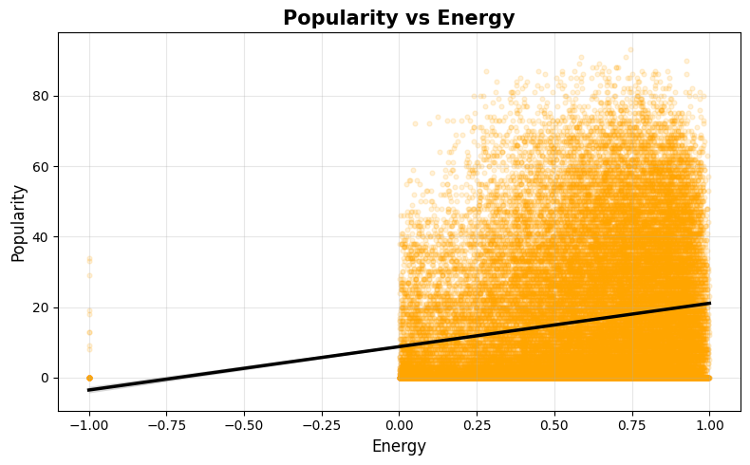
Popularity VS Danceability
Higher energy songs generally tend to be more popular
Low-energy songs are less likely to gain listener attention
The positive trend line shows a direct relationship

Slide 19
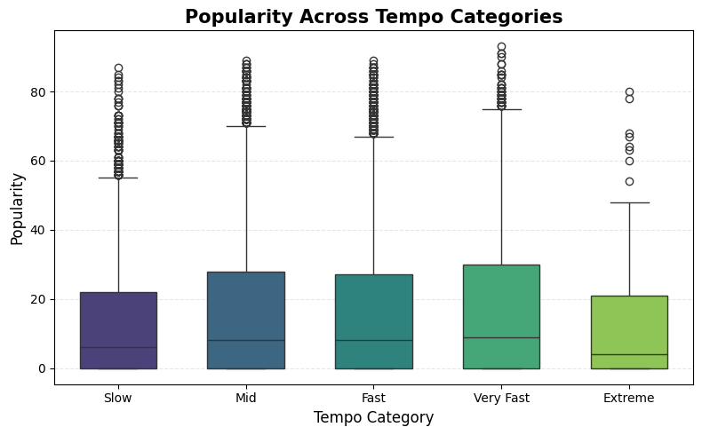
Popularity VS Tempo
Popular songs exist across all tempo ranges
No single tempo category guarantees popularity
Slightly higher variation in medium–fast BPM

Slide 20
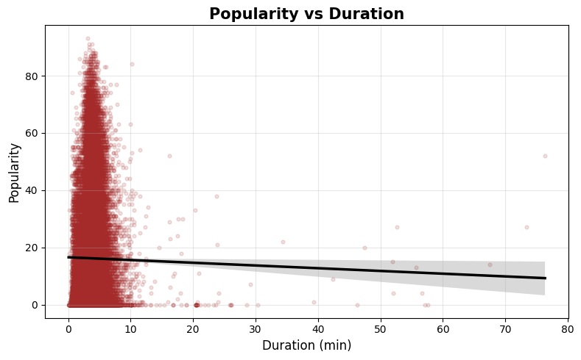
Popularity VS Duration
Songs with duration between (~2–8 min), especially around 3–4 minutes, tend to be more popular.
shorter songs → higher replay value
playlist-friendly
streaming algorithm boosts replay count

Slide 21
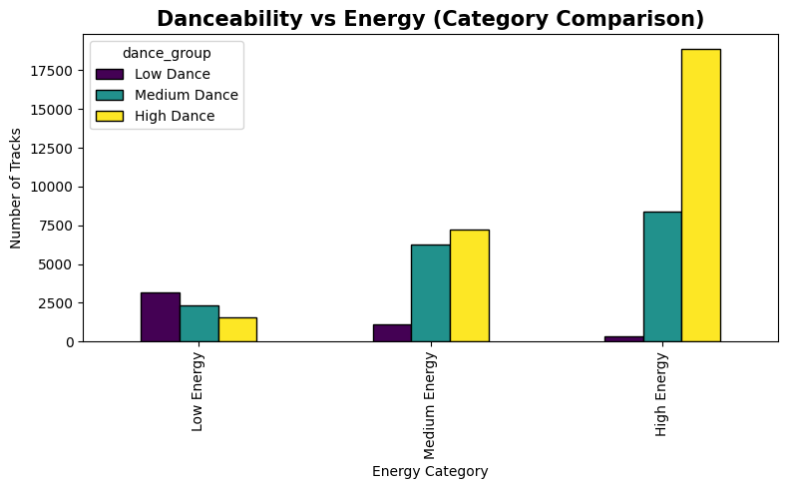
Danceability vs Energy
Clear positive trend between energy and danceability, showing that both tend to increase together.
More energetic songs generally show higher danceability, meaning they have stronger rhythm suitable for movement.
Low-energy songs typically have lower danceability, indicating they are calmer and less rhythm-driven.

Slide 22
Key Insights
There is a mild positive trend between popularity and danceability, indicating that moderately danceable songs have slightly higher odds of becoming popular.
Popularity does not depend strongly on tempo, with successful songs existing across slow, medium, and fast BPM categories.
Popular songs are mostly within a typical duration range (about 2–4 minutes), while extremely long or short tracks are less likely to be hits.
Energy and danceability show a positive relationship, meaning that songs with strong rhythmic energy tend to also be more dance-friendly

Slide 23
Multivariate Analysis
What is Multivariate Analysis?
Multivariate analysis examines relationships among three or more variables simultaneously to understand how multiple features together influence outcomes.
In the upcoming slides we will:
analyze combined relationships among multiple audio features.
observe how different attributes collectively influence song popularity.
will visualize correlations between features using a heatmap.
analyze how energy and danceability interact simultaneously with popularity.
explore how song characteristics evolve over time using year-based trends.

Slide 24
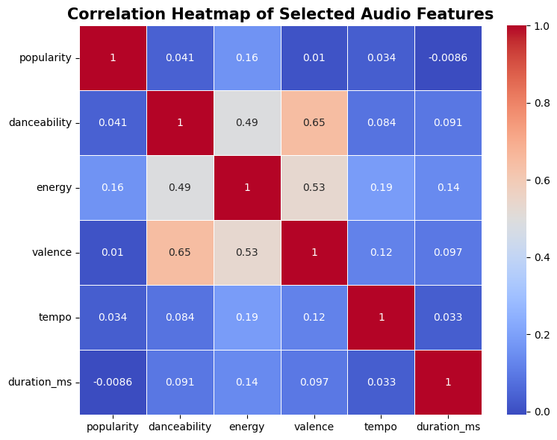
What this heatmap shows: how strongly features correlate from –1 (negative) to +1 (positive)
Correlation Heatmap
Energy and danceability show moderate positive correlation
Popularity does not strongly correlate with any single feature

Slide 25
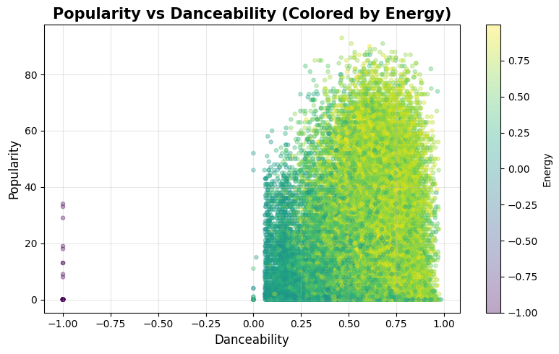
Popularity - Danceability - Energy
Higher danceability songs often also exhibit higher energy.
However, energy does not consistently result in higher popularity, since both energetic and calm tracks appear across popularity levels.
Therefore, while energy strongly influences danceability, it does not strongly determine popularity.

Slide 26
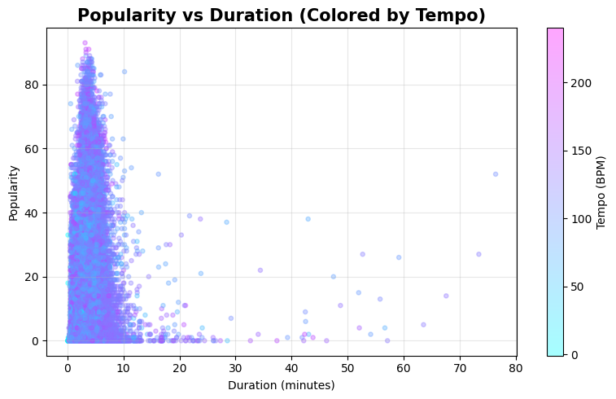
Popularity – Duration - Tempo
Popular songs typically fall in the standard duration range of around 2–4 minutes.
Tempo variation across these durations shows that both slower and faster tempo tracks can be popular.
This suggests that tempo and duration jointly influence engagement rather than individually dictating popularity.

Slide 27
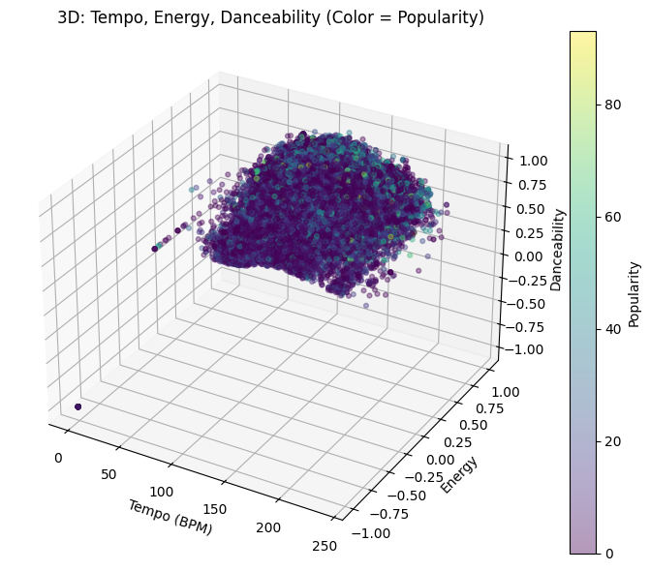
Tempo – Danceability –
Energy - Popularity
Faster tempo songs tend to have higher energy, showing a natural link between speed and musical intensity.
Higher danceability appears more consistently in tracks with higher energy, reinforcing their rhythmic drive.
Popularity (shown by color intensity) is spread across different combinations of tempo and energy, indicating that song success is not tied strictly to one specific musical pattern.

Slide 28
Key Insights
Correlation analysis shows that danceability and energy move together, but popularity weakly correlates with any single feature, confirming it is multi-factor driven.
Multivariate plots reveal that popularity emerges in balanced musical zones rather than at extreme values of tempo, energy, or danceability.
Emotional tone (valence) and song pace show varied combinations, meaning hits can be upbeat, slow, energetic, or melancholic — diversity prevails.
The interplay of tempo, energy, and rhythmic drive highlights structural patterns of modern music, but success still depends on broader audience and cultural context.
Overall, popularity behaves as a combined outcome of multiple musical characteristics interacting rather than a simple linear dependency.

Slide 29
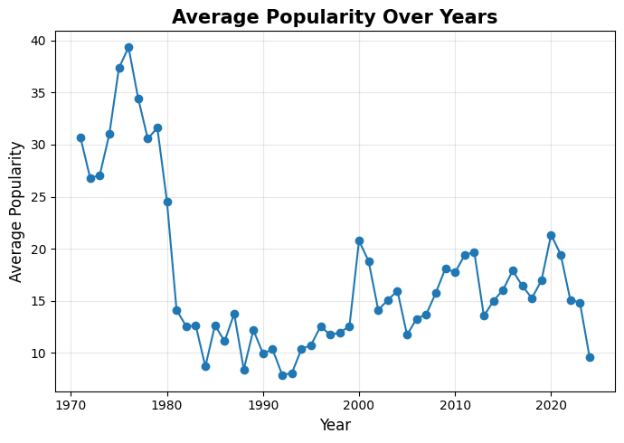
Popularity – Time
Time Series Analysis
Older songs show higher average popularity because they have accumulated plays over longer periods.
Classic or evergreen tracks maintain cultural value and continue to be streamed across generations.
Newer songs may experience short-term spikes but have not had time to build sustained popularity.
Popularity over time is influenced heavily by long-term listener behavior rather than just release date.

Slide 30
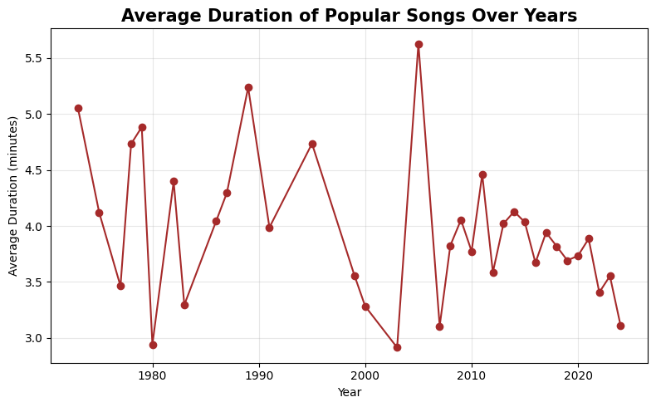
Duration – Time
Average song duration has decreased over time, showing a shift toward shorter tracks.
Older music traditionally had longer compositions, often exceeding 4–5 minutes.
Modern music is typically around 2–3 minutes long, likely to encourage replays and playlist sequencing.
This trend aligns with shorter attention spans and streaming-optimized music structure.

Slide 31
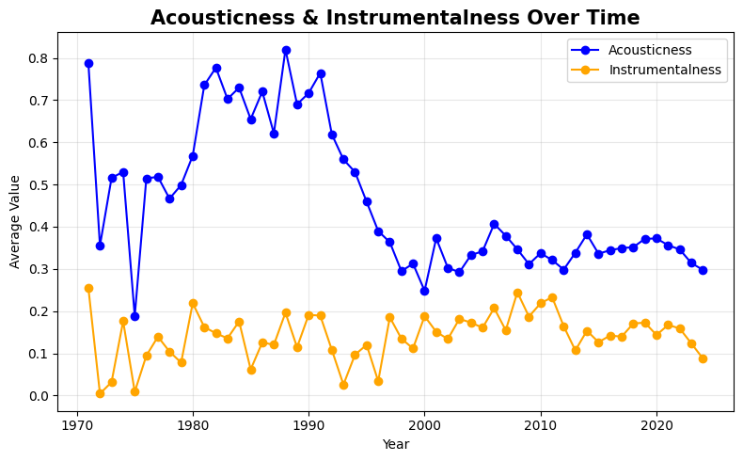
Acousticness - Instrumentalness
Acousticness decreases across decades, indicating movement away from natural acoustic sounds.
Instrumentalness remains consistently low, as most popular modern tracks are vocal-focused.
The industry shift favors studio-produced electronic sound textures over organic instrumentation.
Listener preferences appear to lean toward vocally expressive & digitally crafted tracks.

Slide 32
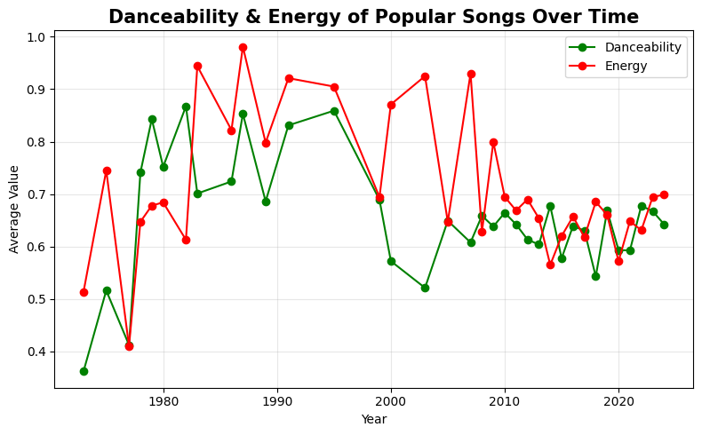
Danceability - Energy
Popular songs consistently remain energetic over time, showing enduring preference for dynamic tracks.
Danceability rises in recent years, reflecting a modern emphasis on rhythm & beat-driven music.
Increasing danceability aligns with trends shaped by clubs, TikTok, reels, and playlist culture.
Energy+Danceability together reveal a strong bias toward movement-friendly, upbeat compositions.

Slide 33
Key Insights
Older songs show higher average popularity, as they have had more time to accumulate streams and achieve sustained cultural relevance
Average song duration has decreased over time, with modern hit songs becoming shorter to encourage repeat streaming and faster engagement.
Acousticness has steadily declined while instrumentalness remains low, reflecting a shift from natural acoustic sounds to digitally produced, vocal-centric music.
Danceability has increased over the years, showing that modern music is more rhythm-focused and suited for movement, clubs, reels, and viral trends.
Energy levels remain relatively high across decades, demonstrating that listeners consistently prefer strong, lively, dynamic tracks.
Older songs show high accumulated popularity, indicating long-term listener loyalty and sustained cultural relevance over time.

Slide 34
Conclusion
Popularity is not driven by any single musical attribute but rather by a combination of energy, danceability, tempo, and song duration.
Most popular tracks fall into moderate ranges for multiple features, showing a preference toward balanced musical profiles.
Emotional tone (valence) does not strongly determine popularity, meaning listeners appreciate both upbeat and melancholic music.
Long-term streaming patterns suggest that older songs accumulate greater popularity over time, indicating sustained cultural value.
Overall, music success appears to be multi-dimensional, reflecting complex listener behavior, marketing influence, and evolving musical trends.

Slide 35
Future Scope
Conduct deeper genre-level analysis to understand how different genres evolve over time.
Incorporate lyrics-based sentiment analysis to assess emotional meaning beyond valence score.
Include external metrics such as social media trends, YouTube views, and radio play to broaden popularity interpretation.
Use machine learning models to predict popularity using multiple musical features.
Study demographic listening patterns (age groups, regions) to identify targeted audience behavior.
Expand dataset beyond Spotify to compare platform-specific popularity across Apple Music, YouTube Music, etc.

Slide 36
THANK YOU!
Presented by:
Tanvir

